Slide 1
PowerPoint Online
Presentation Basics
Notes:
You will need your VPN turned on. Video from YouTube.

Slide 2
Agenda Day 1
Memrise- Level 2
Think/Pair/Share
Video
PPT
Assignment

Slide 3
THINK PAIR SHARE
What makes a good presentation?
When someone teaches you what works? What doesn’t? Examples?
Notes:
10 minute activity

Slide 4
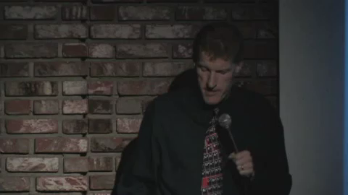
Good/Bad PowerPoint

Slide 5
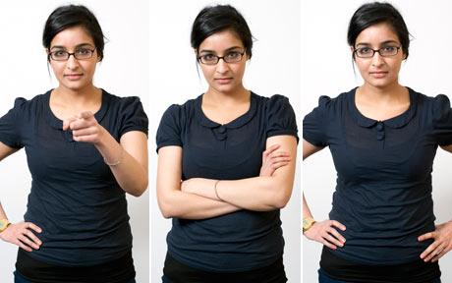
Body Language
Notes:
Show everyone positive body language.

Slide 6

Reading
Notes:
Don’t read from your notes, computer or wall.

Slide 7
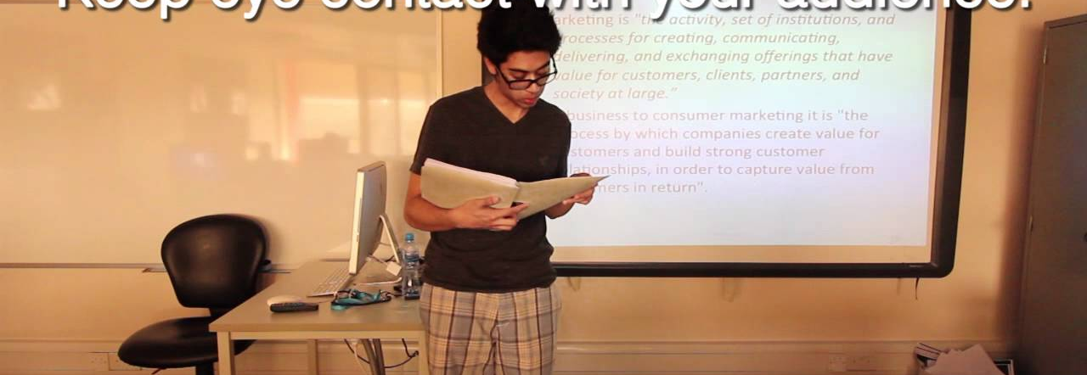
Posture

Slide 8
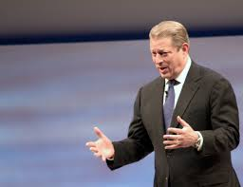
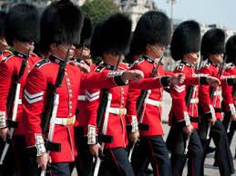
Hand Gestures
Notes:
Don’t be a robot or an army personnel.

Slide 9

Eye contact

Slide 10
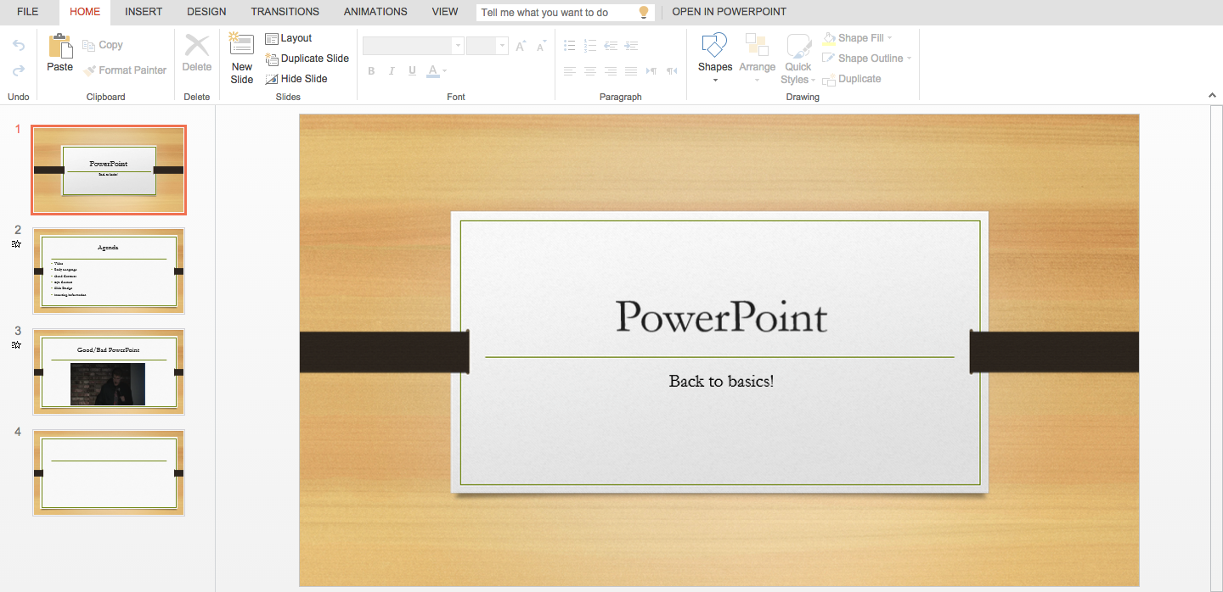
PowerPoint Basics
Notes:
Enter or new slide for a new slide.

Slide 11
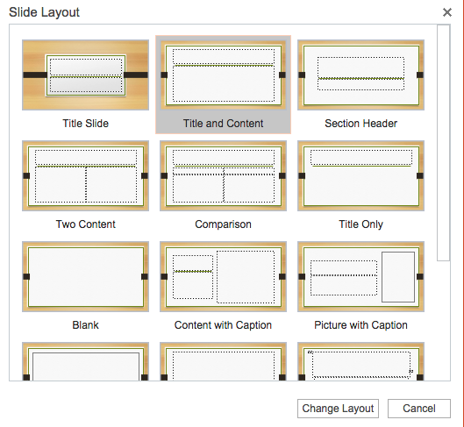
Slide Selection
Notes:
Select slide and use Layout for more options on slide, Which one is the best for comparing information?

Slide 12
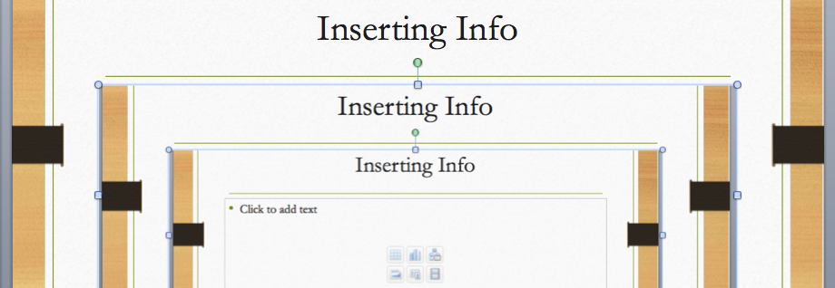
Inserting Info
Notes:
Either start typing or drag and drop the image right into the powerpoint.

Slide 13
Remember to SAVE!
QUICK QUESTION! What is the difference between Save and Save As!

Slide 14
In class activity
Show your teacher the following things before you go.
Start PowerPoint
Have 3 slides
Title slide with your name.
One slide with a picture of your favourite star.
One slide with something you wish your teacher knew about you.
Notes:
If time permits, remaining class time on typing.

Slide 15
Reminder
Next typing test is on Wednesday.

Slide 16
Agenda Day 2
Image Quality
Backgrounds
Full Screen
Ethics and Copyright
Favourite Star

Slide 17
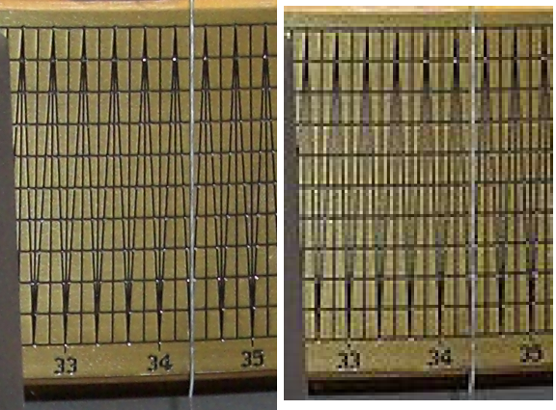
Image Quality GOOD/BAD?
Notes:
The difference between high resolution and low resolution. Don’t simply accept the first image you see.

Slide 18
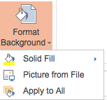

Background
Go to then choose and select pictures from file.
Then choose apply to all if you want it to be on all the slides.
Notes:
For your own background. Follow these instructions!

Slide 19

Full Screen for online
Once you’re finish, you need to press
Then what? How do you make it look nice?
Notes:
Presentation is nearly done. Once your finish and you want to present. You need to go to for screen! F11 is the answer. Or just click view full screen.

Slide 20
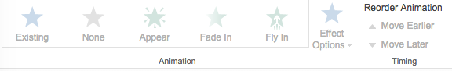
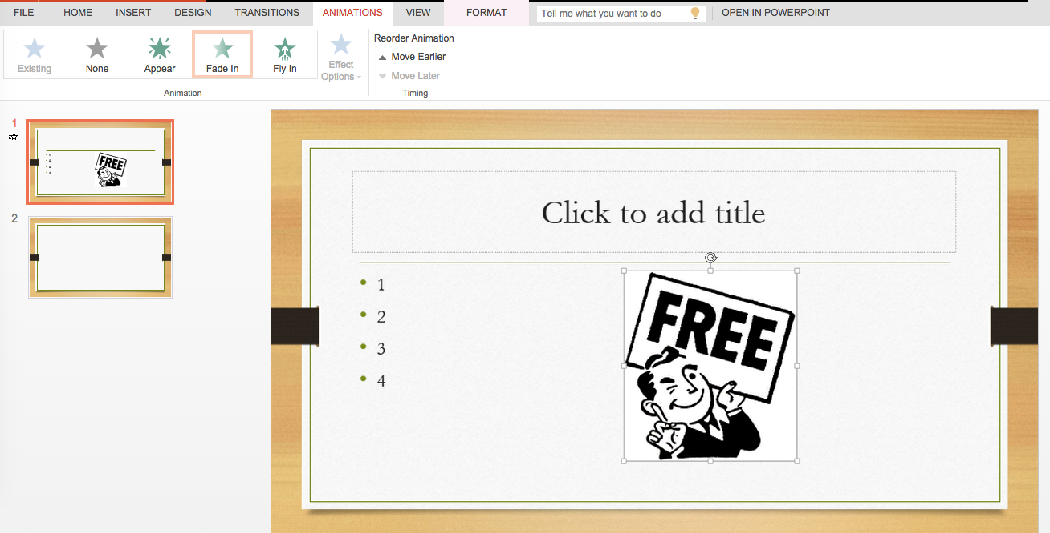
Animation!
Notes:
You can select the order of your animation. Select the words or image select the animation.
The star tells you that there's animation there.
You can change the order and animation on the animation ribbon.

Slide 21
Ethics + Copyright
What does ethics mean?
Copyright?
Intellectual property?
Think Pair Share Time!

Slide 22


IPR
What does this mean to you? What about your own culture?
What is the western culture’s definition?
What is piracy? Why is it not ok?
What about Copyright?
How serious is it?
Notes:
The image is hyper linked to a Chinese site. Teacher Provides the western definition. Go over each point and have students respond.

Slide 23
How Would you Feel
Someone is using your homework to make money and you get nothing. NOTHING! No I mean it not a single RMB! No RMB from your hard work!
Movies, Game, Music, Shows, Programs.
PICTURES!
Notes:
The reason for copyright.

Slide 24
How do you use pictures properly
Did you take it or make it? YES? You can use it.
Did you ask the person if you could use it? Did they say yes? You Can use it!
Is it for educational purposes? You can use it!
Will the image help you get money? Yes? YOU CAN’T USE IT!
Does the website have these logos?
Notes:
For the teacher. http://sarafhawkins.com/copyright-fair-use-and-online-images/
Explain to students the danger of copyright infringement.
Explain plagiarism.

Slide 25
Assignment time!
Checklist!
Bring Laptop and prepare for typing test!

Slide 26
Agenda Day 3
Typing test!
Timing
Transition
Multimedia
Assignment

Slide 27
Typing Test!
20 minutes

Slide 28
Timing
Not on the online version.
Offline version on PowerPoint.
Notes:
Benefit of having this a pre-recorded slideshow?

Slide 29
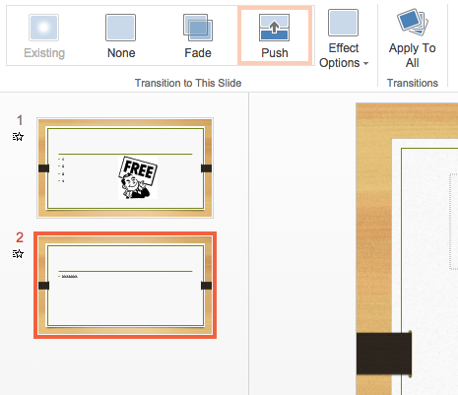
Transitions
Notes:
Choose the slide and then choose the style.
Click Apply to all to apply to all slides.
What is it for?

Slide 30


Multimedia
Online choice. What's YouTube? Doesn’t work.
Offline choices. Choose media in the insert group.
Notes:
The online version does not allow you add sounds yet. Link to YouTube sources.
Offline version. You can add sounds, movies and websites.

Slide 31
Assignment
2 minute presentation on YOU!
Hometown.
Best food
Important location in your town
Where is it in china? Practiced.
2 minutes. PICTURES!
Rubric available.

